Slide 1

Meghan Skelton
Appellate Attorney
Office of the Federal Public Defender
District of Maryland
Meghan_Skelton@fd.org

Slide 2
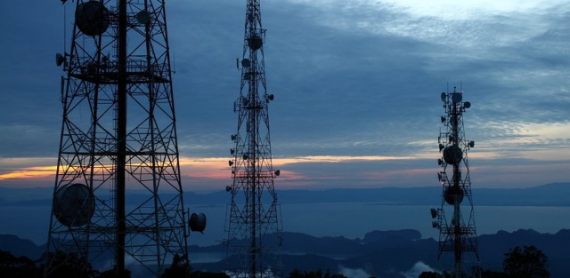
Cell Site Location Information (CSLI)

Slide 3
If it isn’t content, why should we care?
Call detail report typically gives:
  date
  time
  target phone number
  other phone number
  duration
  cell tower
  Sector
  latitude and longitude

Slide 4

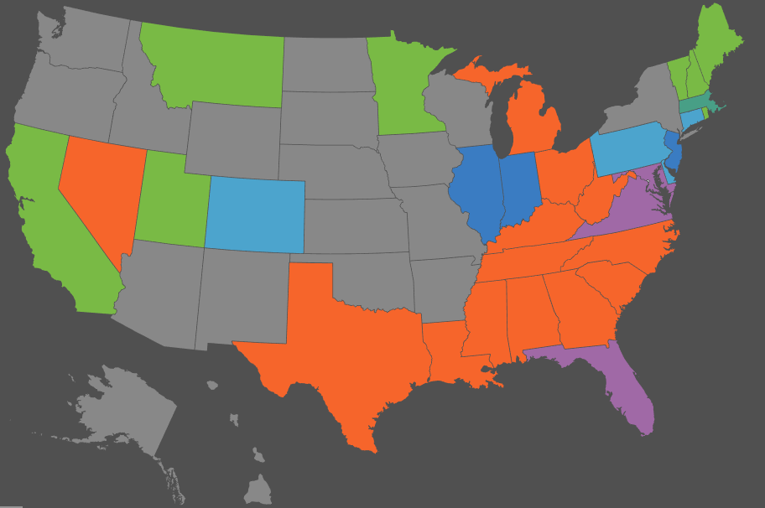
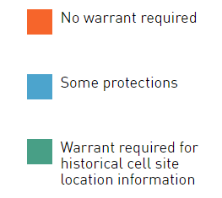
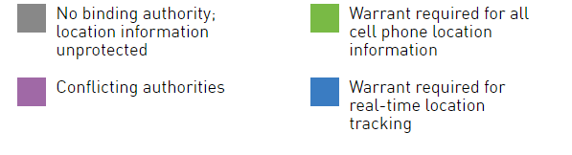
CSLI Protections by State
https://www.aclu.org/map/cell-phone-location-tracking-laws-state

Slide 5



US Circuit Court Decisions
4th Circuit: US v. Graham, 824 F.3d 421 (2016)
5th Circuit: In re Application, 724 F.3d 600 (2013)
6th Circuit: US v. Carpenter, 819 F.3d 880 (2016)
11th Circuit: US v. Davis, 785 F.3d 498 (2015)
3d Circuit: In re Application, 620 F.3d 304 (2010)

Slide 6



State Decisions
Commonwealth v. Augustine, 4 N.E.3d 846 (Mass. 2014)
State v. Earls, 70 A.3d 630 (N.J. 2013)
Tracey v. State, 152 So. 2d 504 (Fla. 2014)

Slide 7
When the Defense Wins:
Courts Focus on Privacy
CSLI reveals information about people and their things inside homes and other private space — expectation of privacy is at its pinnacle
Even more private than GPS – people carry phones on their person, not just limited to where cars go
CSLI provides a comprehensive picture of daily life, movements, associations, and activities
CSLI is more like content than pure routing information

Slide 8
When the Defense Loses:
Courts Focus on Third Party Doctrine
Businesses, not individuals, own/maintain records depicting CSLI, so the government can reach it with a subpoena
People knowingly & voluntarily disclose their location information to the cellular service provider
  Meaning they do not have a subjective or objectively reasonable expectation of privacy (Smith v. Maryland; US v. Miller)
People choose to have cell phones
CSLI is similar to pen registers and people reveal dialed phone numbers to service providers
  CSLI shows only limited routing information

Slide 9
But those courts are WRONG!
Rebutting the Third Party Doctrine Argument
CSLI is generated passively & automatically w/o any user involvement – so not “voluntary”
Users cannot know or control CSLI – so not “knowing”
Disclosing CSLI is at best compelled, not voluntary
CSLI is inherently private, unlike other business records
Subpoenas are insufficient for 4th Amendment “reasonableness”
CSLI is unlike a pen register b/c it shows movement over time, not static, single data point

Slide 10
Rebutting the Third Party Doctrine Argument
Limited disclosure doesn’t invalidate privacy interest
Living off the grid isn’t a prerequisite to 4th Amendment protection
Government asks for the most extreme possible extension of the 3d party doctrine
The S. Ct. has been retreating from the 3d party doctrine for decades now – and has signaled a willingness to revisit it altogether
S. Ct. says do not mechanically apply warrant exceptions to new technology, especially phones

Slide 11

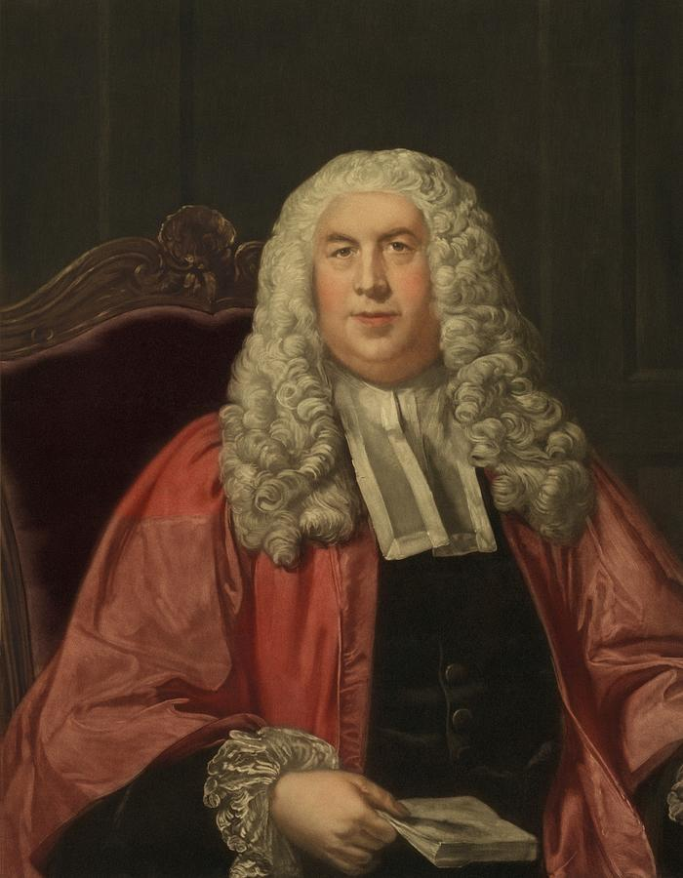
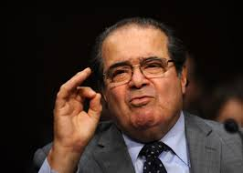
Not just for the curtilage any more
Or the 18th Century
United States v. Jones, 132 S. Ct. 945 (2012) – GPS case
Florida v. Jardines, 133 S. Ct. 1548 (2013) – drug dog on the front porch
Grady v. North Carolina, 135 S. Ct. 1368 (2015) – GPS ankle bracelet

Slide 12

Justice Gorsuch might be interested
Trespass to Chattels
using or intermeddling with a chattel in another’s possession
US v. Ackerman, 831 F.3d 1292 (10th Cir. 2016)
  Government opening & examining files is a trespass to chattels, like the framers tried to prevent
  Jones requires re-thinking old S. Ct. 4th Amend. cases
Register, Inc. v. Verio, Inc., 356 F.2d 393 (2d Cir. 2004)
  The defendant created a software “search robot” to surreptitiously collect the plaintiff’s data.
  Intermeddling with the plaintiff’s data was a trespass to chattels
eBay, Inc. v. Bidder’s Edge, 100 F. Supp. 2d 1058 (N.D. Cal. 2000)
  Electronic signals can cause a trespass
  Accessing data in a way that exceeds the scope of consent is a trespass

Slide 13
Multiple Splits Regarding CSLI
Is there a privacy interest in long-term tracking?
  ✔DC Circuit; NY, MA, NJ / ✖ 5th, 6th, and 11th Circuits
  Do people voluntarily disclose their location data?
  ✔4th, 5th, 6th, 11th Circuits / ✖3d Cir. MA, NJ, FL, N.D. Cal.
  Is there a privacy interest in CSLI?
  ✱Riley described historical CSLI as one of “the privacies of life”
  ✔ MA, NJ, FL, N.D. Cal. / ✖ 4th, 5th, 6th, and 11th Circuits
  If yes, must the government get a warrant?
  ✖ 3d Circuit / ✔ MA, NJ, FL, N.D. Cal.
  ✱ some states have statutes requiring warrants

Slide 14
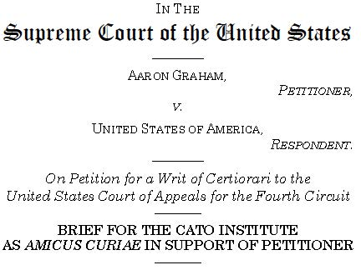
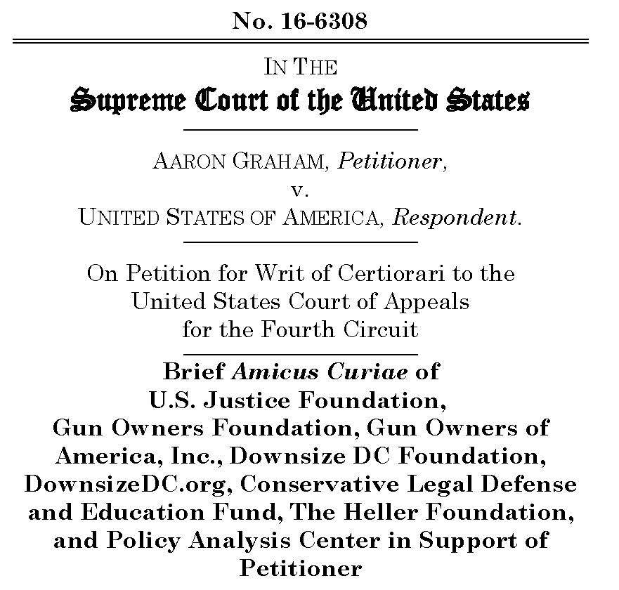
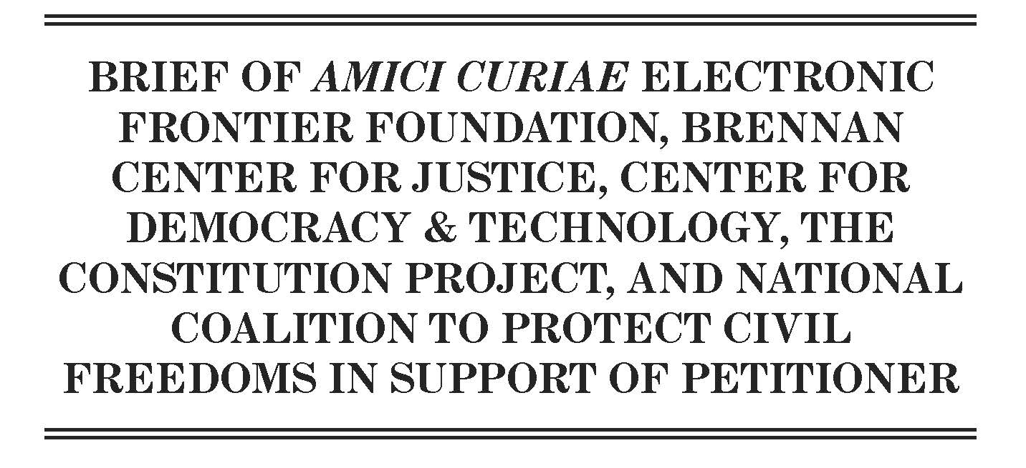

Slide 15

Searching Cell Phones at the Border

Slide 16

Notes:
In the beginner’s mind, there are many possibilities. In the expert’s mind, there are few.

Slide 17

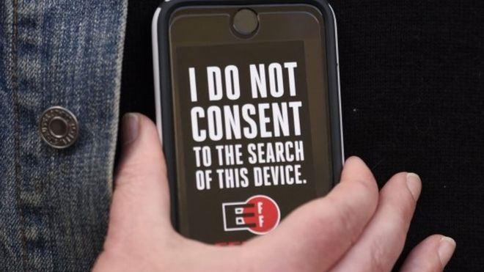
CBP’s press release with statistics on Electronic Device Searches
April 11, 2017
INTERNATIONAL ARRIVALS PROCESSED WITH ELECTRONIC DEVICE SEARCH
 | FY2016 | FY2017
OCTOBER | 857 | 2,560
NOVEMBER | 1,208 | 2,379
DECEMBER | 1,486 | 2,404
JANUARY | 1,653 | 2,756
FEBRUARY | 1,470 | 2,299
MARCH | 1,709 | 2,595
TOTAL | 8,383 | 14,993
Total for FY 2015: 5,000
Total for FY 2016: 25,000
Notes:
Note that first half of FY 2016 accounted for only 1/3 of searches. So if the trend continues linearly, there will be 45,000 in FY 2017.
CBP says this is a small percentage of all international travelers. But the number of houses where a warrant is executed is a small percentage of the number of residences in the US as well.

Slide 18
The government claims absolute, unqualified authority to search any and all digital devices.
The government says searching digital media at the border is reasonable simply because it is at the border.
Actually, this has never been the rule.

Slide 19
Primer: Border Search Warrant Exception
Exception to warrant & probable cause requirement
  because the sovereign has a heightened interest in preventing entry of unwanted persons & effects
  people crossing the border have a diminished expectation of privacy
BUT border searches still must be “reasonable”
To see if a search is reasonable, balance the legitimate government interest against the individual’s recognized privacy interest

Slide 20
Main S. Ct. cases -Not as bad as you think
US v. Ramsey, 431 US 606 (1977)
  Search was reasonable just b/c at the border
  But border search exception is itself “subject to substantive limitations imposed by the Constitution”
US v. Montoya de Hernandez, 473 US 531 (1985)
  Non-routine border search requires reasonable suspicion
  Holding is actually pretty limited to alimentary canal smugglers
US v. Flores-Montano, 541 US 149 (2004)
  Government’s interests are at their “zenith” at the border
  No suspicion necessary to cut open a car’s gas tank
  Government loves this case—says they have “plenary” authority to search
Notes:
There’s a bunch of other cases on roving border patrols, checkpoints, extended border searches. These all require some level of suspicion.

Slide 21

Lower court decisions on digital border search—way better than you think
US v. Cotterman, 709 F.3d 952 (9th Cir. 2012)
  Requires reasonable suspicion to search laptop
  Before Riley
US v. Kim, 103 F. Supp. 3d 32 (D.D.C. 2015)
  Warrantless search is unreasonable!
  Says Riley is a game-changer for digital search cases
US v. Saboonchi, 990 F. Supp. 2d 536 (D.Md. 2014)
  Forensic search of iPhone is “non-routine”
  Requires reasonable suspicion
Cases are pending in the 4th and 11th Circuits – briefing is complete.
  US v. Kolsuz, 4th Cir. No. 16-4687
  US v. Vergara, 11th Cir. No. 16-15059

Slide 22
Argue that the warrant requirement applies
Riley rejects “mechanical application” of old warrant exceptions to new technology
  Government doggedly insists on mechanical application
Riley applies
  Ramsey said the border exception is similar to search-incident-to-arrest exception
  Riley applies to cell phones as a category
  The reasonableness balance test is the same in Riley, Ramsey, Montoya, and Flores
The balance is decidedly in favor of a warrant
  Privacy interests are identical, even though diminished
  Even a heightened gov. interest isn’t enough here
  No need for a warrantless search

Slide 23
Argue that the warrant requirement applies
The S. Ct. repeatedly left open the question of what type of border search would be *too* intrusive
  Ramsey has an “e.g.” cite to examples of two cases that would be too offensive–ransacking offices and homes
  From Riley we know searching a cell phone is more intrusive than searching a home
S. Ct. has never considered a border search as intrusive as a warrantless forensic digital search
  Unlimited time and scope
  Reaches everything that a search of a home reaches – and more
Often, the search won’t be linked to the reasons for the exception (inadmissible persons or contraband)
  Except obviously in CP cases
  Looking for evidence of a crime requires a warrant
Notes:
Even in the most horrible search they considered, they got a warrant after 16 hours

Slide 24
Questions?

