Slide 2
Kim Kardashian Meets with Trump to Discuss Prison Reform

Slide 4
Game of Phones
Caitlin E. Howard & Whitney Z. Bernstein
Federal Defenders of San Diego

Slide 7
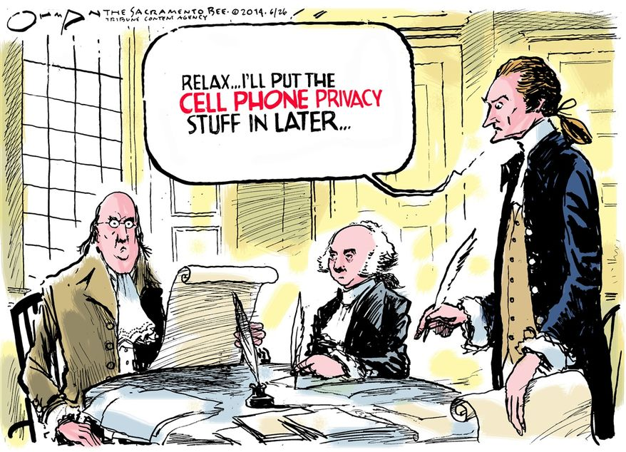
Cell Phones Are Different
“With all they contain and all they may reveal, they hold for many Americans the privacies of life.” Riley v. California, 134 S. Ct. 2473

Slide 8
Different than Other Physical Evidence
More substantial privacy interests are at stake when digital data is involved.
Searches of cell phones are not like searches of physical items.
That is like saying a ride on horseback is materially indistinguishable from a flight to the moon.
Notes:
Immense storage capacity - millions of text, thousands of pictures, hundreds of videos
One place where many distinct types of information are collected that reveal much more in combination than any isolated record
More than 90% of adults who own cell phones keep digital record of nerarly every aspect of their lives

Slide 9
Pull Out Your Phone
Notes:
2 movements to find this info
What does this reveal about your life
Like they said at Supreme Ct roundup this am – Judges more likely to rule in favor of our client’s if they can connect

Slide 10
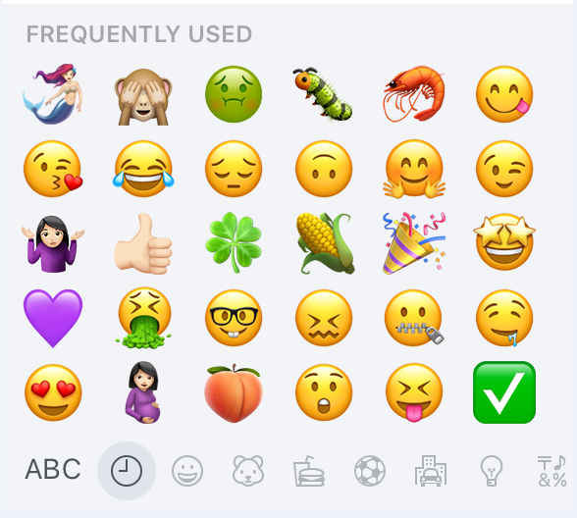
Private Information on Your Phone
Notes:
2 movements to find this info
What does this reveal about your life
Guarantee that your clients have everything on their phones

Slide 11
Put the Court in Client’s Place
Notes:
Like they said at Supreme Ct roundup this am – Judges more likely to rule in favor of our client’s if they can connect
Something that can be accomplished when talking about cell phones
Everyone has cell phones
No one wants cel phone rummaged through

Slide 12
Game of Phones
Border Doctrine
Consent and Warrant Validity
Other Constitutional Challenges
Motions in Limine

Slide 13
Stephanie Lacambra
Criminal Defense Staff Attorney
Electronic Frontier Foundation
815 Eddy St., San Francisco, CA 94109
415-436-9333 x130
stephanie@eff.org

Slide 14
Frequency of Border Device Searches
*FY 2017 estimated
Source: CBP (April 2017), https://www.cbp.gov/newsroom/national-media-release/cbp-releases-statistics-electronic-device-searches-0
Notes:
FY 2017 number was obtained: March 2017 number (2595) x 12 = 31,140.
So we should say that *at least* 31,000 digital searches will take place this year, but the rate may increase.
Fiscal year 2017 = Oct. 1, 2016-Sept. 30, 2017

Slide 15
Border Device Searches: Methods
Demand device password/passcode/PIN
“Manual” = interacting with device as a user would
“Forensic” = software enhanced search
All data on a device
Deleted files in unallocated space
Password-protected or encrypted data
Metadata (e.g., time stamps, GPS coordinates)
Cloud log-in credentials
Notes:
Forensic = logical, advanced logical, and physical extraction

Slide 16
CBP Policy: No Warrant, No Suspicion
“With or without reasonable suspicion,” border agents may search digital devices “and may review and analyze the information encountered at the border” (¶ 5.1.2)

Slide 17
Fourth Amendment: Border Search Exception
“Routine” border searches of travelers’ belongings or persons do not require any individualized suspicion
Warrantless and suspicionless “routine” border searches are “reasonable” because:
“Non-routine” border searches at least require reasonable suspicion that that thing to be searched contains evidence of an immigration or customs violation - U.S. v. Montoya de Hernandez, 473 U.S. 531 (1985)
Government interests in border security
>
Travelers’ privacy interests in luggage
Notes:
Balancing test: Travelers’ privacy interests in their digital data outweigh any governmental interests in conducting warrantless and suspicionless searches of digital data for border security purposes

Slide 18
Border Search Doctrine
Border searches are permitted to enforce the immigration and customs laws, specifically to:
Ensure that travelers entering the U.S. have proper authorization and documentation
Enforce the laws regulating the importation of goods into the U.S., including duty requirements (also exportation/sanctions)
Prevent the entry of harmful people (e.g., terrorists) and harmful items (i.e., contraband) such as weapons, drugs, infested agricultural products, and obscene material/child porn
Notes:
Underpinning of the exception

Slide 19
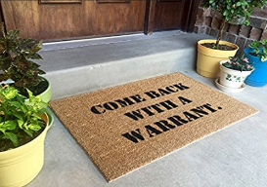
1) Border Search Exception Should Not Apply
Warrantless and suspicionless searches of digital data are not sufficiently “tethered” to border security (i.e., immigrations and customs enforcement) to justify a categorical rule
A probable cause warrant is required for border searches of digital devices
Notes:
Falls outside what is contemplated by border search doctrine, border search doctrine should not apply
Analogize to Riley: SCOTUS found that warrantless and suspicionless searches of cell phones incident to arrest are not sufficiently “tethered” to protecting officer safety and preventing destruction of evidence

Slide 20
1) Border Search Exception Should Not Apply
Border searches of digital data without a probable cause warrant violate the Fourth Amendment.
Key cases:
Riley v. California, 134 S.Ct. 2473 (2014)
Search-incident-to-arrest exception does not apply to cell phone seized during an arrest; probable cause warrant required
U.S. v. Cotterman, 709 F.3d 952 (9th Cir. 2013) (en banc)
“Forensic” border search of digital device is “non-routine” and requires reasonable suspicion
But at least one court found that software is not “forensic” if it only conducts targeted searches of digital data
U.S. v. Feiten, 2016 WL 894452 (E.D. Mich. 2016)

Slide 21
2) All Border Searches of Digital Data are “Non-Routine” (Regardless of Method)
Travelers have significant and unprecedented privacy interests in their cell phones, laptops, and other digital devices
Border searches of digital devices are “highly intrusive” and impact the “dignity and privacy interests” of travelers
Thus, suspicionless border searches of digital devices are “unreasonable”
But what standard should apply?
Notes:
“Highly intrusive” and impact the “dignity and privacy interests” of individuals
Ex: body cavity searches
U.S. v. Flores-Montano, 541 U.S. 149, 152 (2004)
Carried out in a “particularly offensive manner”
Ex: permanent destruction of property by drilling
U.S. v. Ramsey, 431 U.S. 606, 618 n.13 (1977)
What does this mean for border searches of digital data?

Slide 22
Border Search Exception: “Non-Routine” Searches
Supreme Court has not required more than reasonable suspicion at the border
But Supreme Court has not stated that reasonable suspicion is absolute upper limit at the border
But see, US v. Ramos, 190 F.Supp.3d 992 (S.D.CA 2016) – declines to follow Riley at the border

Slide 23
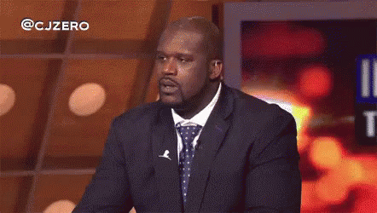
Consent and Warrant Validity
Notes:
Doesn’t end the game

Slide 24
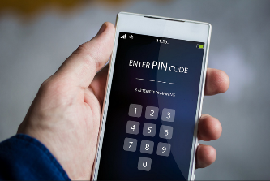
Fifth Amendment Protects Cell Phone Passwords
Border agents asking for device passwords/passcodes/PINs or account/app log-in credentials violates the Fifth Amendment right against self-incrimination

Slide 25
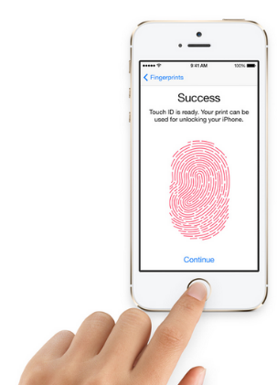
Testimonial vs. Biometric
Information in the mind is “testimonial”
Compare with biometric/thumbprint unlocking features: Physical act; does not involve information in the mind

Slide 26
Overcoming Foregone Conclusion Doctrine
In re Grand Jury Subpoena Duces Tecum Dated March 25, 2011, 670 F.3d 1335 (11th Cir. 2012)
Grand jury subpoena ordering production of decrypted hard drive content (by typing in passwords) violated Fifth Amendment
Government could not show that it knew with reasonable particularity that “certain files” of child porn existed on the devices such that production of decrypted content would not be “testimonial” (i.e., “foregone conclusion” doctrine)

Slide 27
Overcoming Foregone Conclusion Doctrine
Virginia v. Baust, 89 Va. Cir. 267 (2014) [state trial court, citing 11th Cir.]
Compelling defendant to provide password to smartphone (that police suspected had video of defendant assaulting victim) violates Fifth Amendment; password is not “foregone conclusion,” so compelled disclosure is “testimonial”
But compelling defendant to unlock smartphone with fingerprint does not violate Fifth Amendment; physical characteristics are non-testimonial

Slide 28
Requires Miranda When in Custody
U.S. v. Djibo, 151 F.Supp.3d 297 (E.D. N.Y. 2015)
Defendant traveler in secondary screening was “in custody” so phone passcode = “statement;” defendant shared passcode prior to being Mirandized so it was suppressed
Data from phone was further suppressed as “fruit” of non-Mirandized statement
Notes:
Holdings: The District Court, Johnson, J., held that:
1 defendant was in custody and Miranda warnings were required;
2 search of defendant's smartphone was fruit of prior illegal search; and
3 information on phone was not subject to inevitable discovery.
On January 11, 2015, an individual (“Cooperator”) was stopped at John F. Kennedy International Airport (“JFK”) after arriving on a flight from Casablanca, Morocco. The Cooperator was found to have over six kilograms of heroin in his suitcase. Upon arrest, the Cooperator waived his Miranda rights and notified agents of the United States Department of Homeland Security, Homeland Security Investigations (“HSI”) that he received the heroin from an individual in Togo and was planning to deliver the heroin to defendant Adamou Djibo (“Defendant” or “Djibo”) here in the Eastern District of New York.
The Cooperator claimed this was his second time importing heroin from Togo, the first trip having been in May 2014. Immigration records confirmed an “April/May 2014” trip. The Cooperator told agents that Djibo arranged both trips.
The Cooperator's phone was seized and searched. The Cooperator provided what he said is Djibo's telephone number and email address. Text messages (either using the phone's regular messaging platform or a text application called “WhatsApp”) were received from this number and the messages appeared to be coded. Discussions centered around going to a “doctor” who would perform “surgery” on either one, two or three “hands.” The agent believed *299 the “hands” referred to suitcases; the “surgery,” the trips; and the “doctor,” the individual abroad providing the drugs. Emails were also recovered from the Cooperator's phone from the address he claimed was Djibo's. Flight reservations were sent from this address to the Cooperator, and the reservations listed Djibo's telephone number (rather than the actual traveler) as the contact number associated with the reservation. Indeed, the Cooperator informed the government that he never made travel plans himself.
The Court: Okay. And then there came a time that you asked him for the code to his phone. Is that correct?
Wilburt: Yes.
The Court: What was that for? What was the purpose of that?
Wilburt: To get the password to his phone.
The Court: Did he give it to you?
*301 Wilburt: Yes.
The Court: And did you use it?
Wilburt: At a later point, yes.
The Court: What do you mean, at a later point?
Wilburt: I know there was a question whether I put the password in the phone at that time. I don't believe I put it in right when he asked me. I believe it was after the exam was over and after he was arrested, we went back to our office, and then I proceeded to put that code into the phone.
The Court: And did you receive any information?
Wilburt: Yes.
The Court: What information did you receive?
Wilburt: At that point—we have a device called a Cellebrite device. That device pulls all the information off the phone. So another agent used that device after inputting the password, and obtained all the information off the phone that we were able to.

Slide 29
Involuntariness of Statements
18 U.S.C. Section 3501
Wong Sun v. US, 371 US 471
Notes:
Patane – the holding was that the physical evidence (a gun) should not be suppressed because it wasn’t testimonial. Definitely distinguishable from passcode and contents of phone.

Slide 30
So they got a warrant…

Slide 31
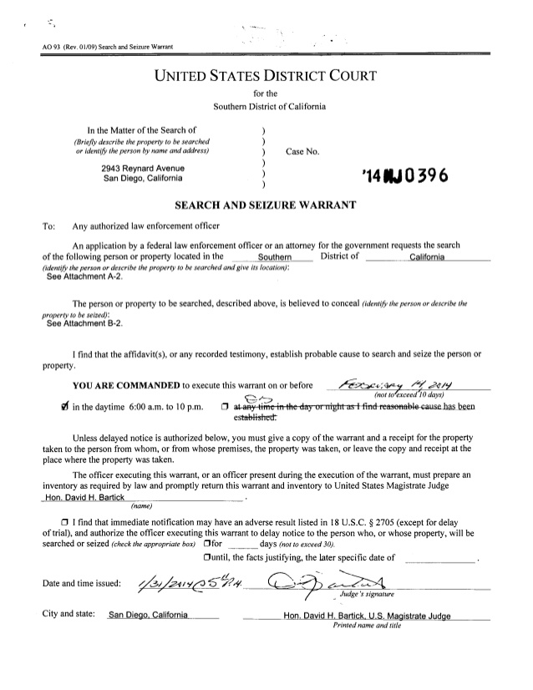
Warrants
1) Lack of Particularity
2) Overbreadth
3) Lack of PC
Notes:
Many ways to attack warrants – in forensic context, in this primer, focus on these 2

Slide 32
Particularity Requirement
The right of the people to be secure in their persons, houses, papers, and effects, against unreasonable searches and seizures, shall not be violated, and no warrants shall issue, but upon probable cause, supported by oath or affirmation, and particularly describing the place to be searched, and the persons or things to be seized.

Slide 33
Particularity Requirement
Does the SW specify the place(s) to be searched?
For example: Digital device searches may often involve cloud searches where the device is used as a portal to data that is remotely stored.
Look for this language:
“Including but not limited to”
“Tending to identify”
Just say “all content within the cell phone”
Notes:
Lack specificity/particularity about the object of the search and place(s) to be searched.
Warrants should be as specific as possible about the files to be searched and the locations on a device where those files are likely to be located.
Where the govt uses the device to access content stored remotely in the “cloud,” object if remote data is not specifically mentioned as an object of the warrant or isn’t within the scope of PC articulated in the SW affidavit.
Ex. FB, dropbox, Twitter, Insta, Snap, bank records, medical records, dating apps.

Slide 34
Particularity Requirement
Specify the relevant time frame and data type
759 F. Supp. 3d 904, U.S. v. Winn (S.D. IL)
Who?
Emails from everyone?
Entire Facebook account?

Slide 35
Particularity
Where affidavit is specific and particular and warrant is broad and not tethered to affidavit.
Nothing should be left to officer’s discretion.
See US v. Kow, 58 F.3d 423 (9th Cir. 1995)
Particularity must be in warrant not in supporting documents.
Groh v. Ramirez, 540 U.S. 551 (2004)
Look at what warrant says.
Notes:
Kow charged with tax fraud. Affidav
Kow charged with tax fraud. Affidavit lists information from an informant and is pretty particular: where tax evasion info is kept. But the warrant authorizes seizure of almost everything.
“. With regard to HK Video's bookkeeping procedures, Gordon summarized information provided by two informants who claimed that HK Video maintained multiple sets of accounting books to avoid paying income taxes. Gordon's more detailed information came from the second informant (“CI–2”), who, for instance, reported that HK Video also falsified its invoices to avoid paying taxes and that the profits of the scheme often were wired through the Bank of Trade to J & P Studios, Ltd., a dubbing business involved with HK Video, or to Ever Spring, a fictitious company sharing the same address as J & P Studios. CI–2 also described where agents could find incriminating documents within H.K. Video's offices.”
it lists information from an informant and is pretty particular: where tax evasion info is kept. But the warrant authorizes seizure of almost evrything.

Slide 36
Scope
Does the warrant permit agents to examine more than what the probable cause justified?
See US v. Griffith, 867 F.3d 1265, 1272-1273 (DC Cir. 2017)
Does the warrant provide any protocol for segregating data that had a nexus to the suspected crime from data that did not?
See US v. Flores, 802 F.3d 1028 (9th Cir 2015).
Notes:
US v. Griffith: given that police did not know whether Griffith owned a cell phone or any other electronic device, they could not describe the devices that they would search for and instead relied on a catchall provision authorizing seizure of every device in the house. NO PC
US v. Flores - the Ninth Circuit recently approved the search and seizure of 11,000 pages of data in defendant's Facebook account in a drug trafficking case, where only approximately 100 pages were ultimately found to be truly responsive to the warrant. Id. at 29 (citing Adjani, 452 F.3d at 1149–50) (“ ‘Over-seizing’ is an accepted reality in electronic searching because ‘[t]here is no way to be sure exactly what an electronic file contains without somehow examining its contents.’ ” (quoting Comprehensive Drug Testing, Inc., 621 F.3d 1162, 1176–77 (9th Cir. 2010) (en banc))).
In United States v. Nazemzadeh, 2013 WL 554054 (S.D. Cal. Feb. 12, 2013), Judge Lorenz approved a warrant authorizing seizure of an entire e-mail server where the affidavit explained the practical limitations, including the length of time required, preventing an on-site search of the e-mail account. Id. at 4.
And in United States v. Garcia-Alvarez, 2015 WL 777411 (S.D. Cal. Feb. 24, 2015), Judge Miller was skeptical that a search confined to “recent data” on a cell phone would have been appropriate, given that the government had no evidence at that point that the alleged smuggling was only recent. Id. at *4.
Making matters worse, the warrant contain no explicit limit on the age of the data searched. It thus allowed seizing and searching data that was entirely temporally divorced from this case. For instance, if an agent believed he needed to search year-old Facebook messages or emails to find information “tending to identify the user of, or persons with control over, or access to, the subject phone,” the warrant let him or her do so.

Slide 37
Procedures for Undertaking Forensic Analysis
What safeguards are included in the warrant?
Pre-execution intervention
Check Out EFF amicus in Commonwealth of MA v. James Keown for sample briefing: https://www.eff.org/Keown
Search parameters?
Dates/Times
Applications
Type of data
If none, argue no reasonable reliance on warrant!
Notes:
Govt must waive reliance upon plain view
Forensic analysis must be done either by specialized personnel or an independent third party.
Govt must disclose the actual risks of destruction & other avenues of access
search protocol must be designed to uncover only info for which govt has probable cause
Govt must destroy or return non-responsive data
Use state statutes for examples of how things should go

Slide 38
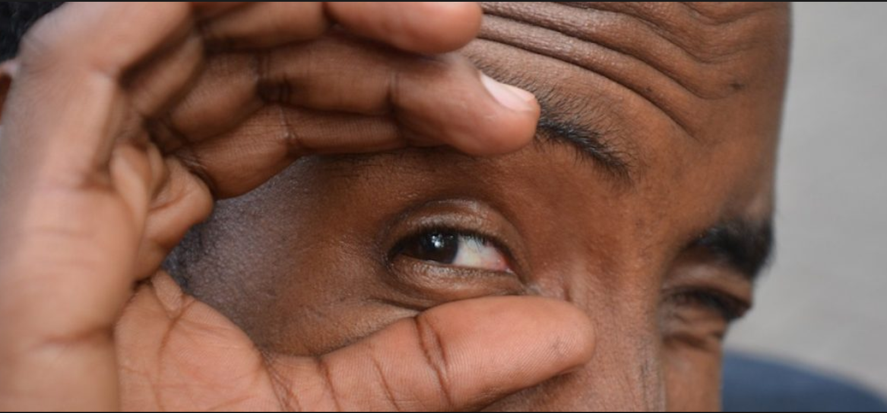
Plain View and Cell Phone Searches
Warrant for some photos and come across CP?
Okay to continue?
Immediately apparent?
Search parameters used?
Any process in place to protect privacy?
The process of segregating electronic data that is seizable from that which is not must not become a vehicle for the government to gain access to data which it has no probable cause to collect.
US v. Comprehensive Drug Testing 621 F.3d 1162
Notes:
Govt got warrant for drug testing records of 10 baseball players, but seized electronic storage devices and copied a directory containing information about urine drug testing on hundreds of players, in addition to the ten mentioned in the warrant, and searched all of the files in the directory, despite conditions in the warrant that precluded them from doing so

Slide 39
First Amendment
Border searches of digital data without a probable cause warrant violate the First Amendment.
Data seizure implicates, burdens, and chills rights to speech, read and receive information, associational privacy, dissent, anonymity, press
Collection of data should be narrowly tailored to government’s interest
Notes:
Emails, texts, messaging apps, photos, videos, notes
Digital music and books, podcasts, browsing history
Contacts, social media friends and followers, calendar entries
Pseudonymous email addresses and social media identifiers
Journalist work product and confidential sources

Slide 40
Can’t Suppress?

Slide 41
Motions in Limine
Preclude Case Agent from Testifying About Cell Phone

Slide 42
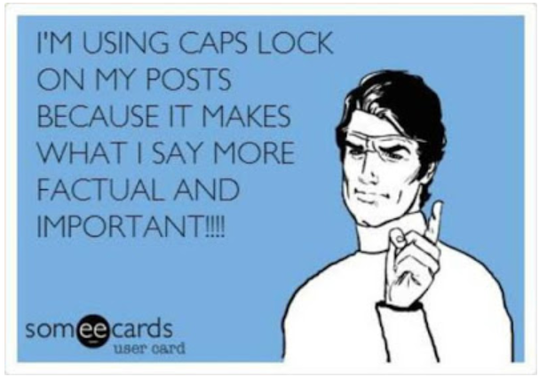
Motions in Limine
This court should exclude the Case Agent as a cell phone expert.

Slide 43
Motions in Limine
Establish Expert Testimony.

Slide 44
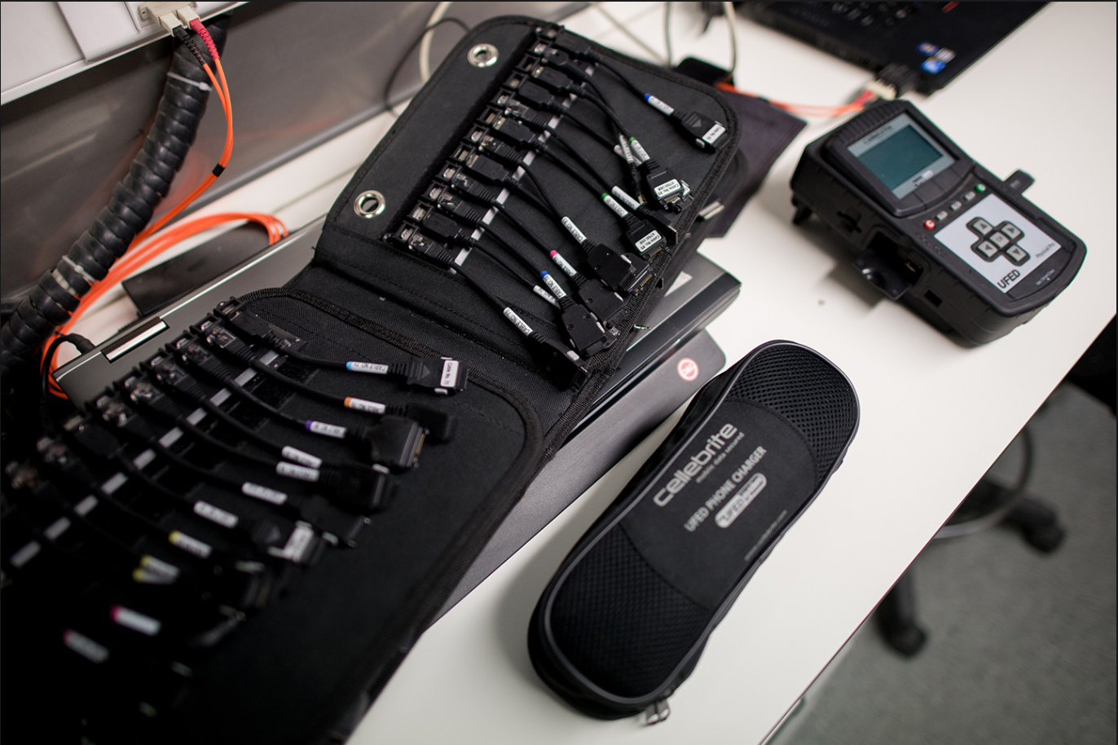
Establish Expert Testimony
Agent extracted data from mobile devices using the Cellebrite Universal Forensic Extraction Device.
Cellebrite is precisely the kind of equipment requiring “scientific, technical, or other specialized knowledge” contemplated by Federal Rule of Evidence 702.

Slide 46
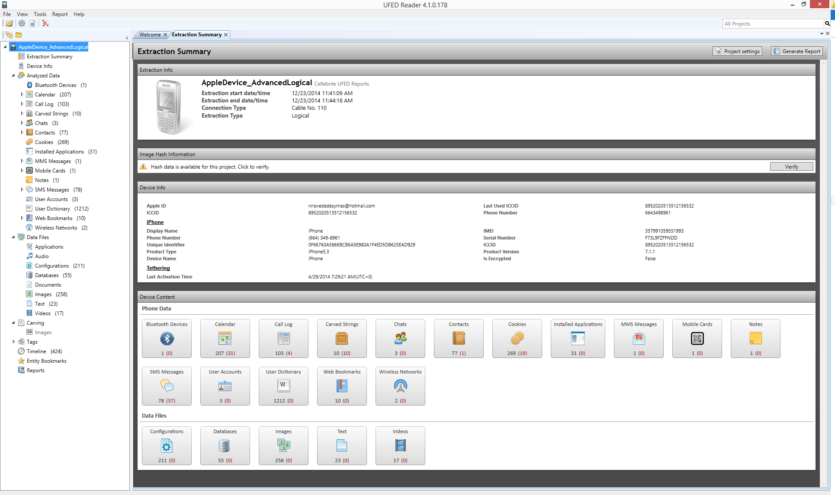

Slide 47
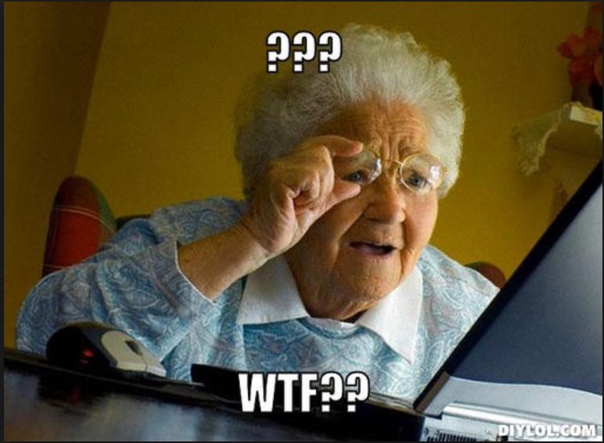
Establish Expert Testimony
Any conclusion about deleted data from a Cellebrite report requires knowledge and analysis of sqlite databases, flash memory, database garbage collection compaction and compression, and mobile forensic tools.
Therefore, in order for Agent to testify, he must first be qualified as an expert.
Notes:
This is not knowledge possessed by a lay person.
Even a basic training in Cellebrite techniques may not confer the necessary knowledge and expertise to reach an opinion about deleted data.

Slide 48
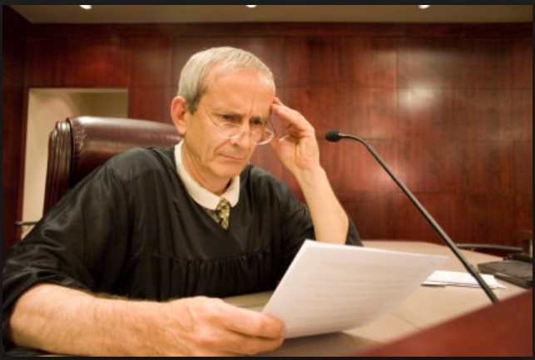
Establish Expert Testimony
Educate the judge with a supporting declaration.
Notes:
See sample materials

Slide 49
Motions in Limine
Establish Expert Testimony
Attack Notice
Demand Daubert
Limiting Instruction

Slide 50
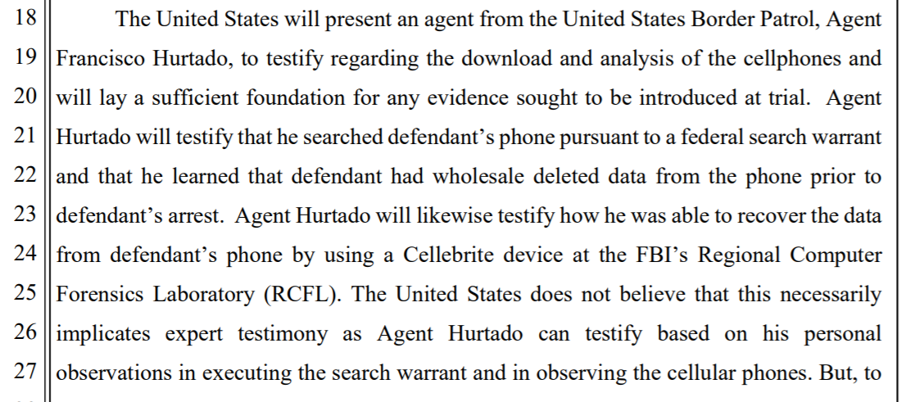
Attack Notice
Notes:
This is not knowledge possessed by a lay person.
Even a basic training in Cellebrite techniques may not confer the necessary knowledge and expertise to reach an opinion about deleted data.

Slide 51
Attack Notice
Fed. R. Crim. P. 16(a)(1)(G)
summary of the opinions of its experts to be used during its case-in-chief
“[t]he summary . . . must describe the witness’s opinions, the bases and reasons for those opinions, and the witness’s qualifications.”
Notes:
Here, the government’s one paragraph in its motions in limine is insufficient notice under the rules and fails to provide Mr. Garcia-Morales with the proposed expert’s bases and reasons for his opinions, methods of reaching his opinions and conclusions, and qualifications.
This frustrates Mr. Garcia-Morales’ ability to evaluate the government’s evidence against him, investigate the government’s evidence, prepare a defense, and prepare for trial.
At this point, introduction of any expert testimony will violate Mr. Garcia-Morales’s Fifth and Sixth Amendment Rights. See United States v. Barrett, 703 F.2d 1076, 1081 (9th Cir.1983) (“[F]airness requires that adequate notice be given the defense to check the findings and conclusions of the government’s experts.”) (citations omitted).
Prejudice results when the defendant is unable to attack the credibility of the government’s witness due to receiving late notice and late test results and findings. Id. This Court has the authority to preclude an expert witness when the timing is late. See, e.g., United States v. W.R. Grace, 526 F.3d 499, 508-09 (9th Cir. 2008) (en banc); see also Fed.R.Cr.Pro. 16(d)(2)(C).

Slide 52
Demand Daubert
Agent’s qualifications?
Any training in Cellebrite?
Any certificates in Cellebrite?
Followed the appropriate protocols and methodologies in extracting data?
Notes:
This is not knowledge possessed by a lay person.
Even a basic training in Cellebrite techniques may not confer the necessary knowledge and expertise to reach an opinion about deleted data.

Slide 53
Limiting Instruction
Cannot testify about opinion
What a Cellebrite download can show
What should be there
What agent expected to be there
If agent believed content had been deleted off phone
At most, only testify as percipient witness of what is actually visible on an otherwise admissible phone
Notes:
Agent Huratdo is allowed to testify regarding data found on any cellular device, he should be limited to only testifying about the location of the data and not be allowed to speculate about who or when any data was deleted
could not testify regarding any opinions (e.g., as to
what a Cellebrite download can show, what should be there, what he expected to
be there, or if he believed had deleted content off of his phone).
The Court further said that it was inclined to allow him to testify as a percipient
witness to facts that came from the Cellebrite report.

Slide 54
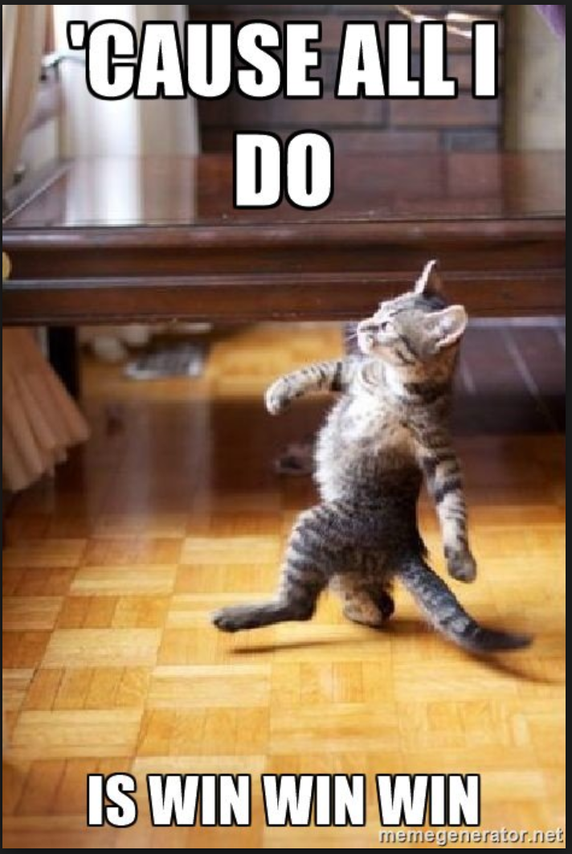
Motions in Limine
Establish Expert Testimony
Attack Notice
Demand Daubert
Limiting Instruction
Notes:
See samples

Slide 55
Getting some knowledge
Electronic Frontier Foundation
National Institutes of Standards and Technology
Scientific Working Group on Digital Evidence
DOJ

Slide 56
Stephanie Lacambra
Criminal Defense Staff Attorney
Electronic Frontier Foundation
815 Eddy St., San Francisco, CA 94109
415-436-9333 x130
stephanie@eff.org

Slide 57
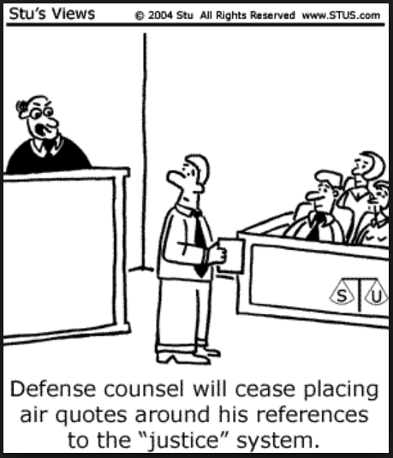
Notes:
Things have been shitty

Slide 59
Be The Dragon

