Slide 1
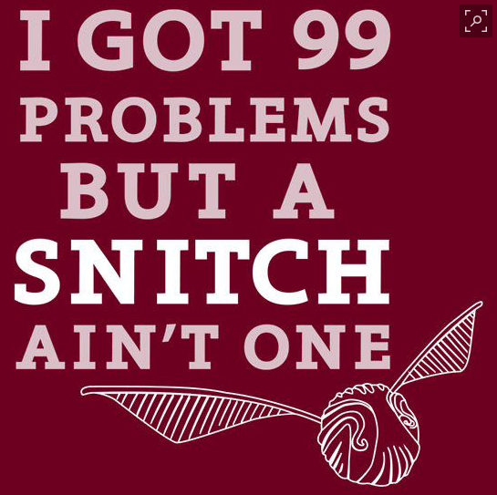
Shereen Charlick
Chief Trial Attorney
Kasha Castillo
Supervising Trial Attorney

Slide 2
Making the Snitch Not Your Problem
What We Should Demand from Prosecutors
What We Can Get Ourselves
What We Have to Litigate to Get
What to do With the Sh** you Get

Slide 3
What Should We Demand

Slide 4
Rule 16 Giglio/Brady Material
Reports of Investigation -- including “Trial Prep”
Criminal history: state/federal/arrests
Plea agreement/letters from gov’t, text messages to & from agents, PSIs.
Any benefits offered by gov’t– including immigration benefits, S-visas, U-visas, parole letters, quashing subpoenas
Grand Jury Testimony if there is arguably any “inconsistency”

Slide 5
“Soft Words of Hope”
Representations that are vague and open-ended, not considered a “promise” mandating disclosure
“Soft words of hope” are more damaging than explicit promise in writing
Notes:
Not just conviction jacket. All of them.

Slide 7
Title

Slide 8
“Soft Words of Hope”
Whenever a government agent makes a representation to a cooperating witness that he knows or reasonably should know could create a subjective expectation of leniency – must be disclosed
Helps us “because it’s the right thing to do”
Or so we can help you “help yourself.”
Notes:
Not just conviction jacket. All of them.

Slide 9
Title

Slide 10
Title

Slide 11
A-File

Slide 12
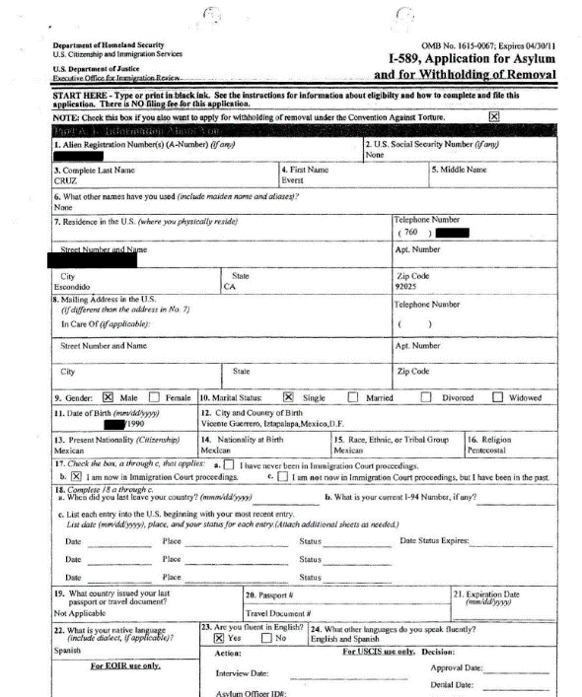

Slide 13
“Hope” Includes
Inducement made by government to counsel for the witness is Giglio. See Campbell v. Reed, 594 F.2d 4, 6 (4th Cir. 1979) (finding Giglio violation when state made promise of non-prosecution to accomplice's lawyer, and lawyer merely told witness that “everything would be all right”)
“Everything will be all right” if witness cooperated. Campbell v. Reed, 594 F.2d 4, 6 (4th Cir. 1979)

Slide 14
“Hope” Includes
A promise to jailhouse snitch “cooperation will be made known” to the judge. Patillo v. State, 368 S.E.2d 493, 498 (Ga. 1988), cert. denied, 488 U.S. 948 (1988).
Prosecutor’s statement that he would take the “cooperation into consideration” at sentencing; Commonwealth v. Hill, 739 N.E.2d 670, 680 (Mass. 2000)\;

Slide 15
Title

Slide 16
Title

Slide 17
What Can We Get Ourselves
Transcripts/guilty plea forms/police reports
Personal interview? It could happen
Attend any court hearing Snitch/Complaining witness has
Accurint Reports
DMV records

Slide 18
The Power of Social Media

Slide 19
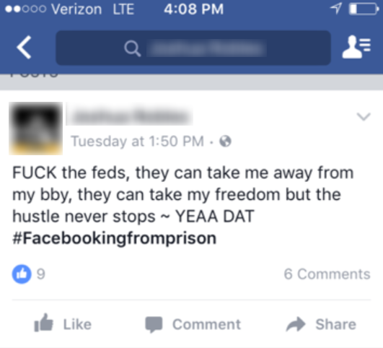

Slide 20
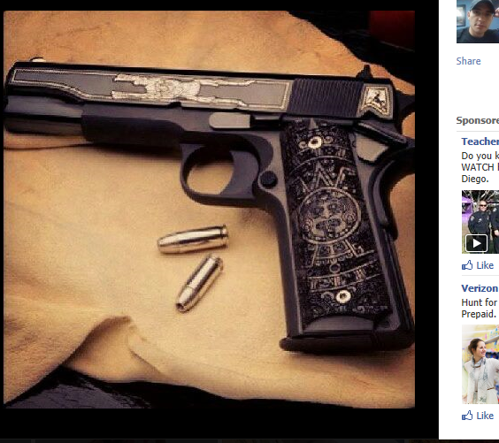
The Snitch Ain’t No Saint

Slide 21
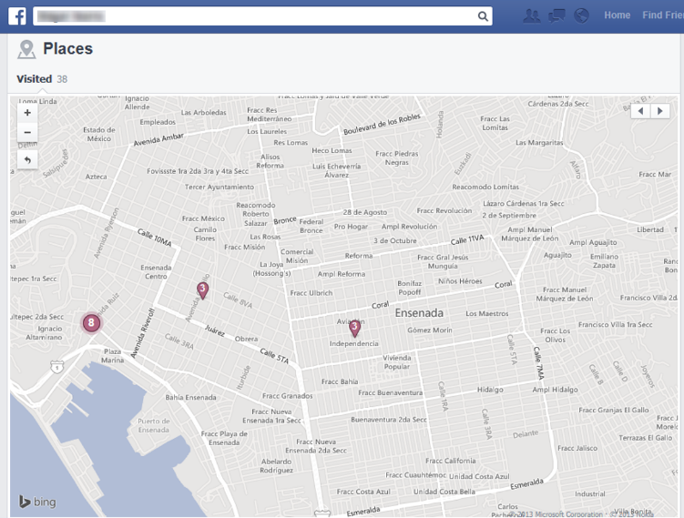
Facebook Can Show Us Where Pictures Were Taken
Notes:
So you say you have never been to Tijuana, hu?

Slide 22
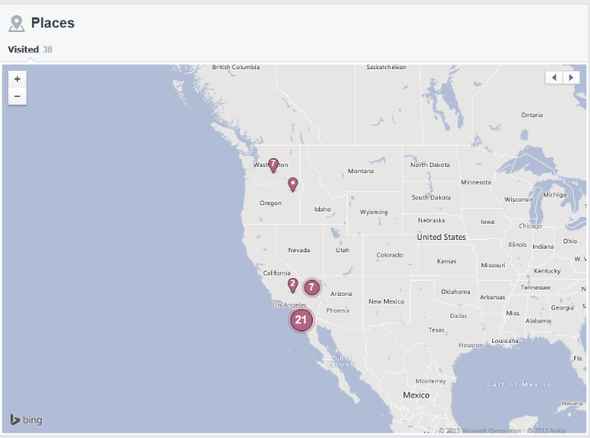
Facebook Can Give Us the Dates of Those Photos
Notes:
So you say you say you were in Arizona in March of 2018?

Slide 24
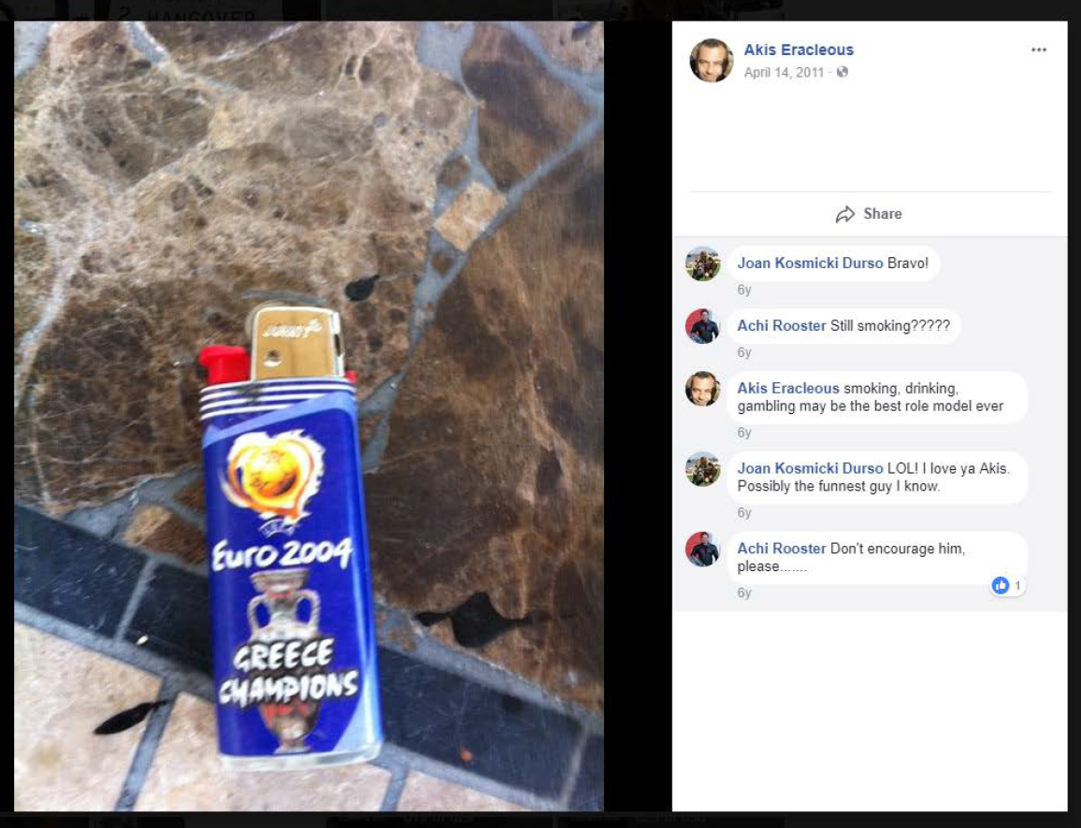

Slide 25
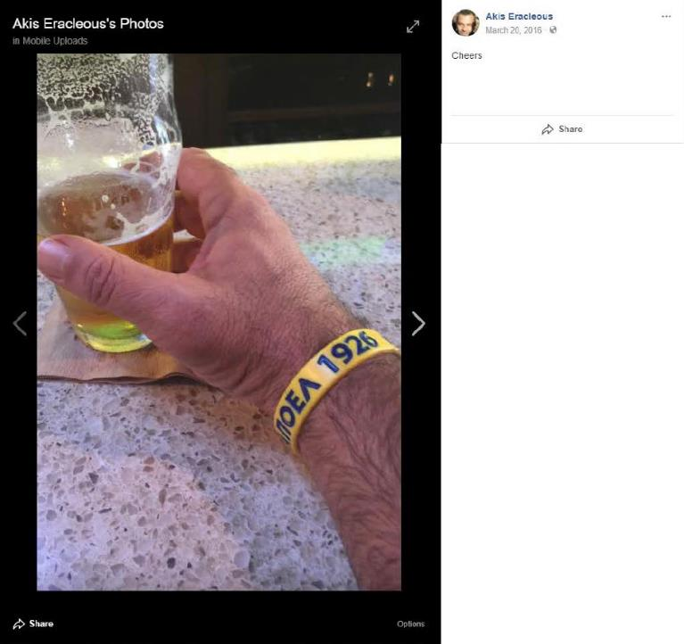

Slide 26
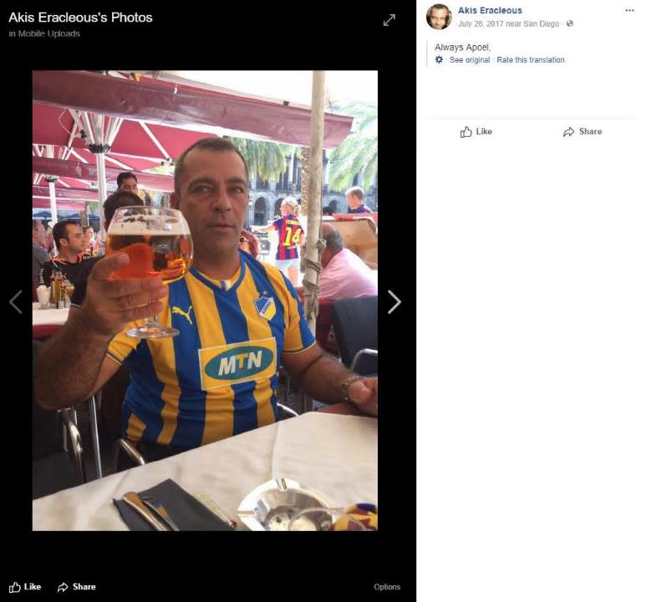

Slide 27
How Do We Get It?
All Public Sites
Client is “friends”
Someone else is “friends”
Maybe request production

Slide 28
How We Don’t Get it
You can’t be “friends”
Your investigator can’t be “friends”
You can’t subpoena it

Slide 29
The Power of 17(c)

Slide 30
Impeachment material need not be subpoenaed for advance production because its relevance depends upon the government’s decision to call the witness
United States v. Nixon, 473 U.S. 683 (1974); United States v. Fields, 663 F.2d 880 (9th Cir. 1981)

Slide 31
The Use of 17(c) is Encouraged
Complicated Cases (not a very high threshold)
Where it is known with certainty the witness will testify
Allow a more orderly trial
United States v. LaRouche Campaign, 841 F.2d 1176 (1st Cir. 1988); United States v. King, 194 F.R.D. 569, 574 (E.D. Va. 2000)

Slide 32
What Can We Subpoena?
Credit Reports
Sealed filings and/or Other Law Suits: did the “victim” file a civil suit?
Divorce records: ex-spouses should be interviewed
Insurance Records
Records under other names (Aliases)
Downloads of Snitch’s cell phones
Access to private locations

Slide 33
AND MORE . . .
Prison Records
Work Records
Medical Records
School Records
Social Security Records
Notes:
Prison records – switching of clothes
Work records – bad acts on the job
Medical records - subpoena Brown v. United States, 567 A.2d 426 (D.C. 1989)

Slide 34
Employment Records

Slide 35
Jail Calls

Slide 36
Jail Calls

Slide 37
Conviction Records

Slide 38
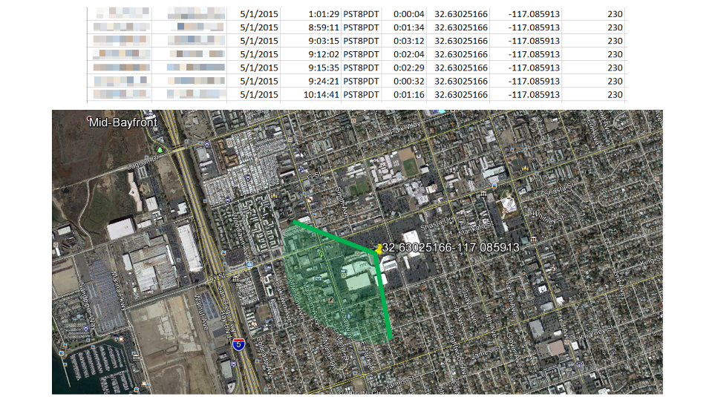
Phone Records and Cell Sites
DATE TIME DURATION LAT LONG AZIMUTH

Slide 39
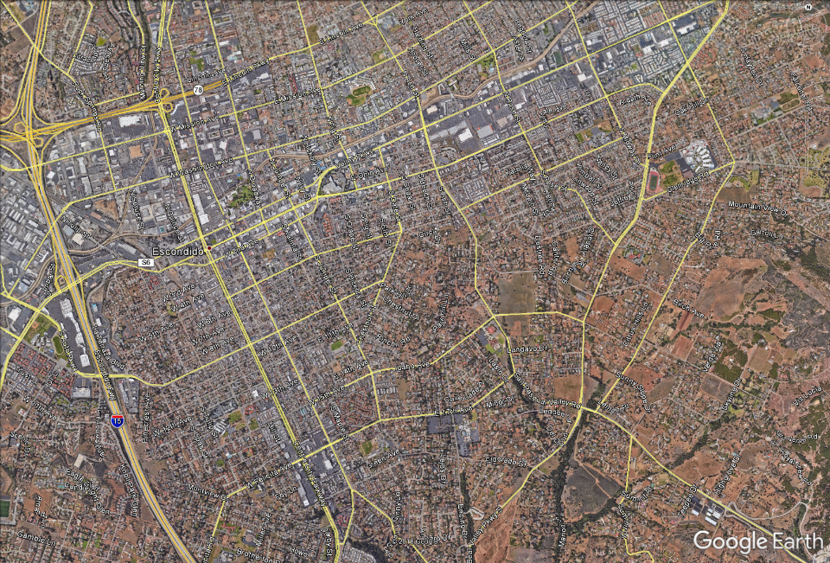
Location of
Shooting
Client’s House

Slide 40
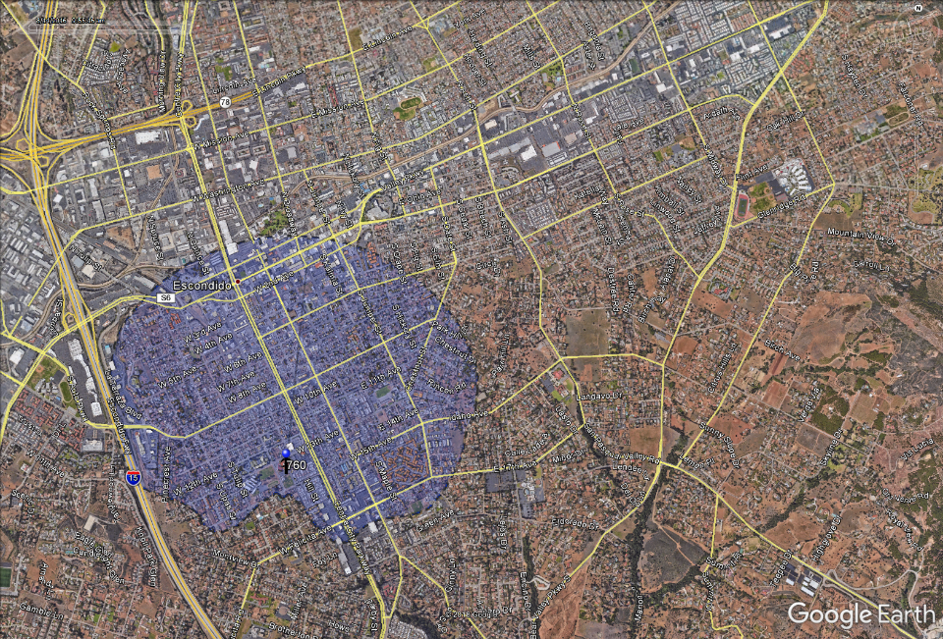
Location of
Shooting
Client’s House

Slide 41
Text Messages

Slide 42
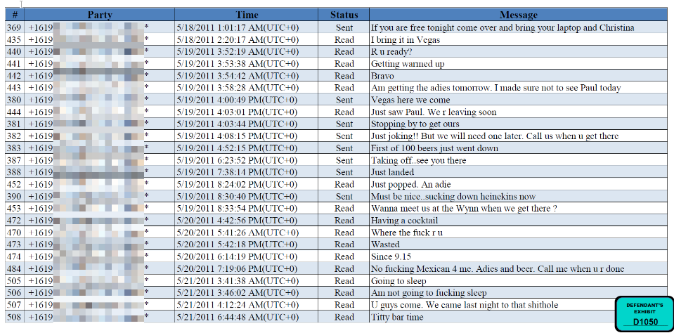

Slide 43
What We Litigate
I.D. issues?? File a motion and ask for a hearing so get witness on cross before trial
In limine motion to exclude “truthfulness” language from plea agreement & from direct examination; no admission of full plea agreement by prosecutor
May have to litigate 608(b)/609/404(b) issues
Defense has no obligation give 404(b) notice
Fed. R. Evid. 404(b) (“the prosecution, in a criminal case, shall provide reasonable notice . . . .”)
You can find some reason to admit the evidence: “motive, opportunity, intent, preparation, plan, knowledge, identity, or absence of mistake or accident.

Slide 44
LEGAL TOOLS
Rule 404(b): Prior Act Evidence
Standards for defense admission “relaxed”
United States v. McClure, 546 F.2d 670 (5th Cir. 1977);
United States v. Cohen, 888 F.2d 770 (11th Cir. 1989)
United States v. Absoumoussallem, 776 F.2d 906, 911-912 (1984)
Trial judges have no authority to order you to turn over impeachment material.
United States v. Cerro, 775 F.2d 908, 915 (7th Cir. 1985)
Rule 16/Cal.Pen.Code 1504.3 do not require disclosure of impeachment evidence
Right to Cross includes attacking credibility, bias, motive, self-interest.
Burr v. Sullivan, 618 F.2d 583, 586-587 (9th Cir. 1980)
United States v. Payne, 944 F.2d 1458, 1469 (9th Cir. 1991)
Rule 608(b): prior acts involving dishonesty:
Frauds/use of fake names, deceptions, infidelity
See United States v. Gay, 967 F.2d 322, 328 (9th Cir. 1992)
Notes:
Never “agreement.” Always DEAL.
Beware prior consistent statements. Tome v. United States, 513 US 150 (1995)

Slide 45
Bias/Motive
“The exposure of a witness' motivation in testifying is a proper and important function of the constitutionally protected right of cross-examination.”
Davis v. Alaska, 415 U.S. 308, 316 (1974)

Slide 46
Bias/Motive
Where counsel seeks to explore a witness' bias on cross-examination-rather than his character for truthfulness-Rule 608(b) is not controlling.
U.S. v. Ray, 731 F.2d 1361, 1364 (9th Cir.1984) (“Rule 608(b) does not bar introduction of evidence to show that the witness is biased.)

Slide 47
Bias/Motive
“We cannot overemphasize the importance of allowing full and fair cross-examination of government witnesses whose testimony is important to the outcome of the case.... Full disclosure of all relevant information concerning their past record and activities through cross-examination is indisputably in the interests of justice.”
U.S. v. Brooke, 4 F.3d 1480, 1489 (9th Cir.1993)

Slide 48
This Must Include:
Sentencing Guidelines Faced Before Cooperation
Avoided Minimum Mandatories. United States v. Larson, 495 F.3d 1094 (2007).
Dismissed Charges In Exchange for Testimony. Delaware v. Van Arsdall, 475 U.S. 673 (1986)
Grants of Immunity
Provisions of the Plea Agreements Relating to Rule 35. United States v. Schoneberg, 396 F.3d 1036, 1043 (9th Cir. 2005)
Provisions of the plea agreement establishing AUSA had the sole discretion to determine truthfulness and substantial assistance. United States v. Schoneberg, 396 F.3d 1036, 1043 (9th Cir. 2005)

Slide 49
This Must Include:
Probationary Status. Davis v. Alaska, 415 U.S. 308 (1974)
Implicit Promises of leniency. McGeshick v. Fiedler, 3 F.3d 1083 (7th Cir. 1993)(witness testified that he was told that if he cooperated, “maybe things would go easier for him,” although no clear promises were made) – The Soft Words of Hope ….
Expectations or Hopes of Leniency. Commonwealth v. Evans, 512 A.2d 626 (PA. 1986)(court recognized that witness may have testified in favor of prosecution in order to receive favorable treatment in an unrelated crime, even though prosecution had not made any agreements or promised to make any agreements to that effect).

Slide 50
This Must Include
Fear Of Possible Charges. Davis, 415 U.S. at 317 (the witness’s “possible concern that he might be a suspect in [an] investigation” could have motivated him to falsely implicate the defendant was within the scope of cross).
Inmate Status. Alford v. U.S., 282 U.S. 687 (1931)
Special Favors/Amenities in Custody. Chavis v. NC, 637 F.2d 213 (4th Cir. 1980)

Slide 51
OTHER AREAS OF CROSS
Prior Statements
Prior Convictions
Prior Arrests
Prior Bad Acts
Character/Truthfulness
Omissions
Defects in Capacity
Perceive/remember

Slide 52
How to Be Persuasive
i.e.,
how to make the Sh** you get work for you.

Slide 53
Know Your Enemy
3 Types of Cooperating Witnesses
Different Obstacles
Different Biases
Different Image Goals

Slide 54
The Eye Witness
Charged with unrelated criminal charges, but claims to have witnessed some part of the events in question

Slide 55
Housed at the same facility with your client
Claims to have overheard “admissions” made by your client

Slide 56
The Co-Actor
Arguably the most dangerous
Perfect eye witness to the crime and admissions made by your client
Feels really bad about what happened and just wants to tell the “truth”

Slide 57
The Art of Persuasion

Slide 58
Percentage of Information Retention
50

Slide 59
1ST FBI INTERVIEW

Slide 60
1ST FBI INTERVIEW

Slide 61
1 WEEK LATER RECORDED INTERVIEW W/ BEST FRIEND

Slide 62
1 WEEK LATER RECORDED INTERVIEW W/ BEST FRIEND

Slide 63
1 WEEK LATER RECORDED INTERVIEW W/ BEST FRIEND

Slide 64
USE CHARTS OR TIMELINES
Hector the Organizer
Sandra the Recruiter
Aaron the Innocent
Carlos the best friend
Sammy the Snitch
Notes:
Visual learners, use cool colors.
Helps keep you accurate without notes.

Slide 65
USE CHARTS OR TIMELINES
Hector
the Organizer
Sandra
the Recruiter
Aaron
the Innocent
Carlos
the best friend
Sammy
the Snitch
Notes:
Visual learners, use cool colors.
Helps keep you accurate without notes.

Slide 66
PRIOR INCONSISTENT STATEMENTS
Snitch
becomes
Star witness
Incident;
Snitch arrested
Snitch’s atty
Contacts
prosecution
Snitch
Denied
bail
_____________________________________________________
Snitch meets with
prosecutor
Snitch
Confesses
Client not
mentioned
Snitch learns
Possible
sentence
Notes:
WARNING!!!

Slide 67
I am here to tell the truth
Date of arrest
First debrief
Trial
I am the one who did this
Aaron didn’t know anything
I am the one who did this
Aaron knew but didn’t organize anything
Sure, I knew but wasn’t my idea
Aaron organized and was going to pay me $500

Slide 69
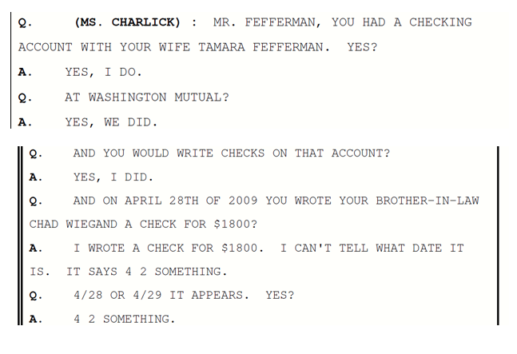
Using Bank Records

Slide 70
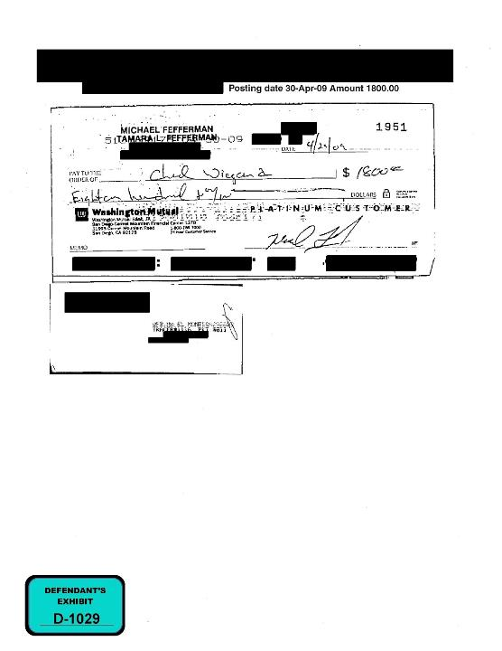

Slide 71
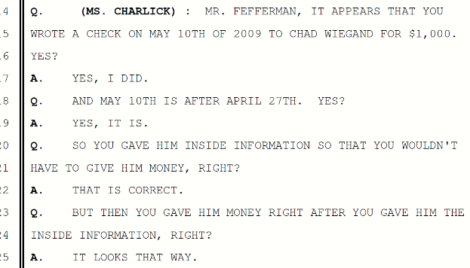
Title

Slide 72
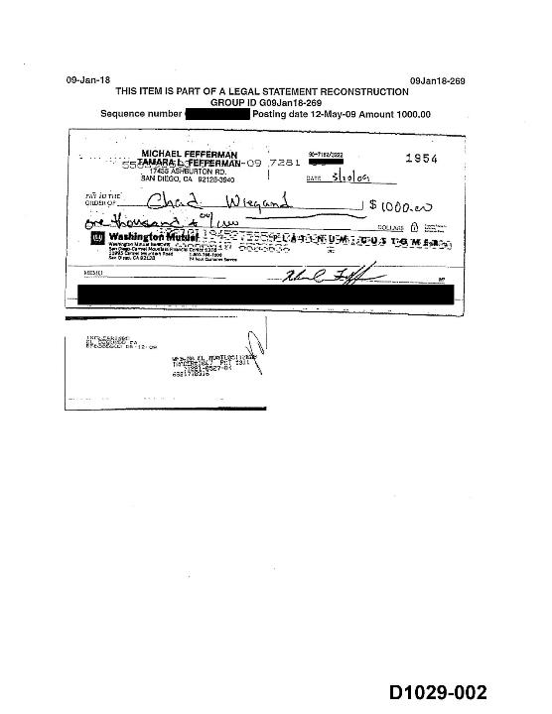

Slide 73
Add Ammunition to Your Arsenal

Slide 74
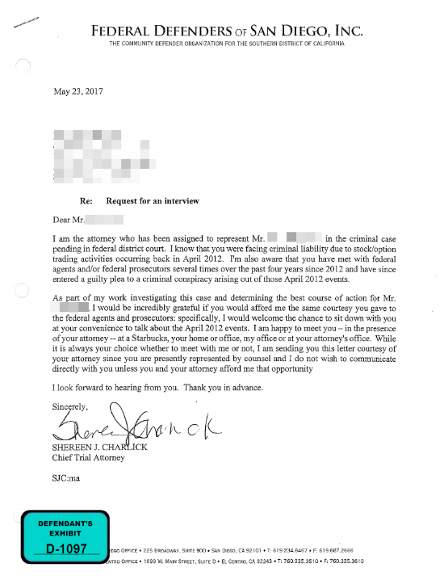

Slide 75
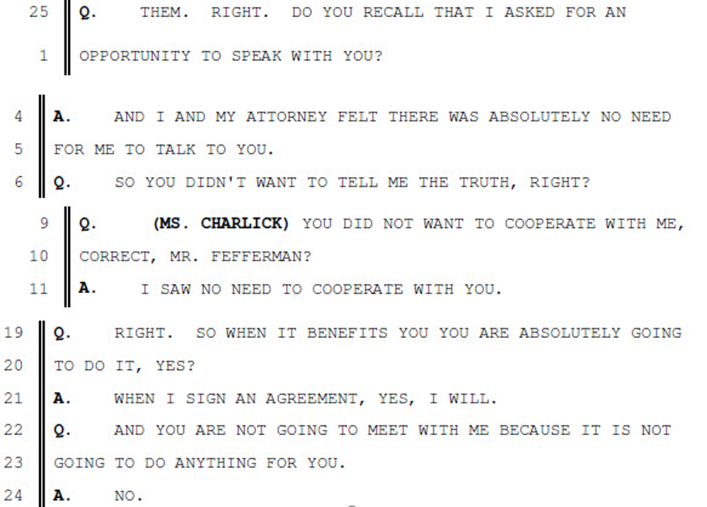

Slide 76
Common Snitch Problems
“I am just here to tell the truth.”

Slide 77
Do you need to come to federal court to do that?
You can tell the truth to your wife?
You can tell the truth to your mama?
You can tell the truth to god in Church?
You don’t need to come to court and sit up there and answer my questions to “just tell the truth.”

Slide 79
The truth is:
But you do have to come to court to “tell the truth” to “help yourself out” to get a benefit
And speaking of “the truth,” let’s talk about who decides if you are telling the truth?
Because it isn’t your wife or your mama, right?
And isn’t even God?
And it sure isn’t me? IT’s THEM

Slide 80
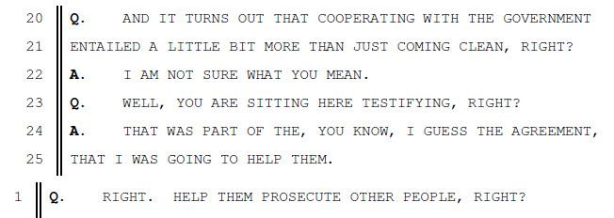
All I have to do is “Cooperate”

Slide 81
“Substantial Assistance”

Slide 82
Substantial Assistance?
Substantial means a lot?
a whole lot?
And Assistance means helping out?
So according to your deal, you have to help THEM out a whole lot?

Slide 83
THOMAS JEFFERSON Letter Aug. 19, 1785
He who permits himself to tell a lie once, finds it much easier to do it a second and third time, till at length it becomes habitual; he tells lies without attending to it, and truths without the world's believing him. This falsehood of the tongue leads to that of the heart, and in time depraves all its good dispositions.

Slide 84
THE END

