Slide 1
Anatomy of an Appellate Brief
Dan Kaplan
AFPD - Phoenix, Arizona

Slide 2
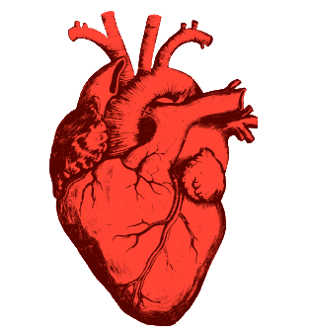
HEART = NARRATIVE = STORY

Slide 3
Storyless (i.e., heartless) Statement of Facts
The government charged Defendant with …
At trial, Officer Johnson testified …
Next, Agent Smith testified …
Finally, Defendant testified …

Slide 4
Storytelling Statement of Facts
John’s crime began and ended when, on the afternoon of Sunday, February 3, 2008, he placed a batch of Priority Mail parcels in a mailbox in Glendale, Arizona. The parcels did not contain explosives or poisons, real or counterfeit. They contained speech.

Slide 5
The government first called Ms. Jones to testify on the second day of trial. She testified that she “fell down behind the vehicle” while Mr. Jones was backing up.

Slide 6
The government first called Ms. Jones to the stand on the second day of trial. She testified that she “fell down behind the vehicle” while Mr. Jones was backing up.
The prosecutor accused Ms. Jones of perjury, and suggested that the court appoint a lawyer to represent her.
The next day, the prosecutor called Ms. Jones to the stand again and asked her whether she wanted to “correct” her testimony …

Slide 7
Naming the characters
“Defendant”

Slide 8
Passive v. Active Voice
Mr. Jones’ wife received “road rash”-type abrasions when a Ford Explorer he was driving backed up while she was behind it.

Slide 9
Mr. Jones ran over his wife with a Ford Explorer.

Slide 10
“Bad Facts”
Omit?
Footnote?
“Finesse”

Slide 11
Passive Voice
Mr. Jones’ wife received “road rash”-type abrasions when a Ford Explorer he was driving backed up while she was behind it.

Slide 12
“Although”
Although Officer Miller claimed that safety considerations prompted him to search Mr. Smith, he articulated no basis for believing that Mr. Smith was armed or posed a danger.

Slide 13
Reverse-primacy-and-recency
After Mr. Smith presented two credit cards, which were declined, he left the store.

Slide 14
Identify as assertions
Officer Miller testified that he was concerned that Mr. Smith was reaching for a weapon.

Slide 15
Unnecessary Facts
On July 12, 2017 . . .

Slide 16
In the Summer of 2017 . . .

Slide 17
Two days later . . .

Slide 18
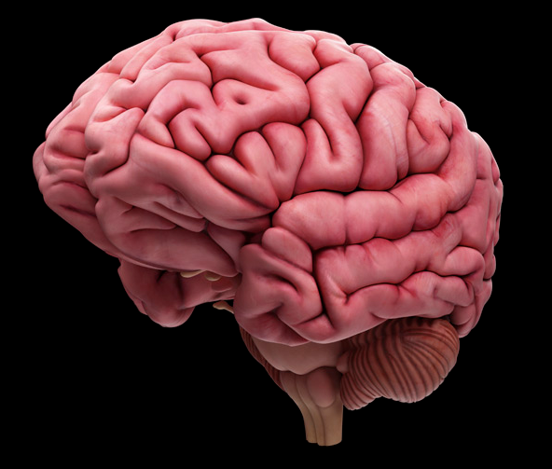
BRAIN = ARGUMENT

Slide 19
Maintaining the Heart-Brain Connection
Don’t tell – show.

Slide 20
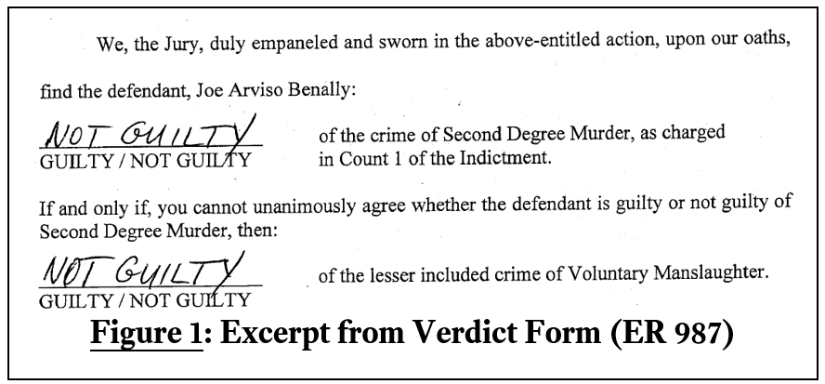
Using Adobe and the “snipping tool”

Slide 22
Structuring Issues: Decision Tree*
Judgment of Acquittal
New Trial
Resentencing
* Jurisdiction – appeal waiver, time bar, mootness; “preservation” issues

Slide 23
Structuring Analysis: Clear Promises, Clearly Kept
The search was unlawful for three reasons.
First, …
Second, …
Finally, …

Slide 24
Structuring Dependence and Independence of Arguments
Stressing the independence of your arguments:
Even if … the search was still unlawful …
Assuming, arguendo, …
The search suffered from three independently-fatal flaws.
Stressing the interdependence of the government’s arguments:
The government’s position would be valid only if … and … and …

Slide 25
Ergo?
Because …, the Court should ____________
Reverse for entry of judgment of acquittal
Reverse and remand for a new trial
Vacate the sentence and remand for resentencing
Other?

Slide 26
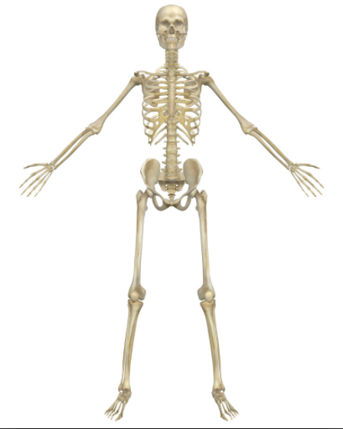
Skeleton = Captions

Slide 27
Jabba the Hut
Statement of Facts
The Arrest
The Trial
The Sentencing
Argument
The search was unlawful
The Sentence was unreasonable

Slide 28
Statement of Facts
After James Smith was injured in the course of a fight with Mr. Williams, the government charged Mr. Williams with two counts of assault.
Mr. Williams asked the district court to give the jury a self-defense instruction, but the court refused.
Two witnesses described portions of the fight between Mr. Williams and Mr. Smith, but did not describe how Mr. Smith was injured.
Argument
The district court erred by refusing to give the jury a self-defense instruction.

Slide 29
Using captions to highlight “good facts” and “good law”
In the Statement of Facts:
After 20 minutes of running checks, Officer Miller knew that he didn’t “have anything on” Mr. Smith, but continued the detention.
In the Argument:
The agents failed to “diligently pursu[e]” a means of investigation that was likely to resolve their suspicions “very soon.”

Slide 30
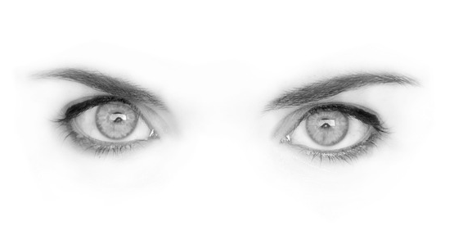
Eyes = Statement of Issues

Slide 31
Whether the district court erred in denying defendant’s request for a self-defense instruction.

Slide 32
Refusal to instruct jury on self-defense. A district court commits per se reversible error when it refuses a criminal defendant’s request that it instruct the jury on a defense that is supported by law and has some foundation in the evidence. It was undisputed here that Mr. Jones’ requested self-defense instruction was supported by law, and the trial evidence indicated that Mr. Smith was injured, likely by a knife, during a fight with Mr. Jones, but did not establish who introduced the knife into the fight or how Mr. Smith was injured. Did the district court err in refusing to give the jury a self-defense instruction?

Slide 33
Refusal to instruct jury on self-defense.
(Identify the issue “at a glance.”)

Slide 34
A district court commits per se reversible error when it refuses a criminal defendant’s request that it instruct the jury on a defense that is supported by law and has some foundation in the evidence.
(Identify the rule governing the issue.)

Slide 35
It was undisputed here that Mr. Jones’ requested self-defense instruction was supported by law, and the trial evidence indicated that Mr. Smith was injured, likely by a knife, during a fight with Mr. Jones, but did not establish who introduced the knife into the fight or how Mr. Smith was injured.
(Summarize undisputed facts relating to the issue.)

Slide 36
Did the district court err in refusing to give the jury a self-defense instruction?
(Identify the ultimate question, with standard of review.)

Slide 37
Face = Introduction

Slide 38
Introduction
John Miller is a 39-year-old construction worker, field laborer, father of three, and member of the Gila River Indian Community, which occupies a reservation just south of Phoenix, Arizona. In early 2014 Mr. Miller had a fight with his father’s girlfriend’s son Albert Jones, during which Mr. Jones sustained a wound to the side of his head. The government charged Mr. Miller with assault resulting in serious bodily injury and assault with a dangerous weapon. The prosecutor struck an Asian-American from the jury over Mr. Miller’s objection, explaining (among other things) that the juror volunteered at science fiction conventions “which leads to giving more weight to fantasy rather than fact.” Mr. Miller’s defense at trial was self-defense, but the district court refused to give the jury a self-defense instruction. Over Mr. Miller’s objection, the district court permitted the government to state in its closing argument that one of its witnesses testified that he saw Mr. Miller “slashing at” Mr. Jones with a shiny object, although the witness only testified to Mr. Miller “[t]rying to get” Mr. Jones with something shiny, evidently from the opposite side of a door. The jury convicted Mr. Miller of assault resulting in serious bodily injury but acquitted him of assault with a dangerous weapon, and the district court sentenced him to 108 months of incarceration. Mr. Miller now appeals.

Slide 39
John Miller is a 39-year-old construction worker, field laborer, father of three, and member of the Gila River Indian Community, which occupies a reservation just south of Phoenix, Arizona.
(Humanize the client with facts from the Presentence Report.)

Slide 40
In early 2014 Mr. Miller had a fight with his father’s girlfriend’s son Albert Jones, during which Mr. Jones sustained a wound to the side of his head. The government charged Mr. Miller with assault resulting in serious bodily injury and assault with a dangerous weapon.
(Identify the factual core of the case)

Slide 41
The prosecutor struck an Asian-American from the jury over Mr. Miller’s objection, explaining (among other things) that the juror volunteered at science fiction conventions “which leads to giving more weight to fantasy rather than fact.” . . .
(Flag the facts that relate to your issues.)

Slide 42
The jury convicted Mr. Miller of assault resulting in serious bodily injury but acquitted him of assault with a dangerous weapon, and the district court sentenced him to 108 months of incarceration. Mr. Miller now appeals.
(Identify the case’s procedural path to the circuit court.)

